Slide 1
E-Xplore the Globe: How do I sign up?
Step 1. bit.ly/RestWorld and complete the details using your university email address, followed by the Sign up button.
Step 2. You will then receive a confirmation email to verify your account.

Slide 2
How do I sign up?
Step 3. Once you have clicked sign up, your account will be validated.
Step 4. You will then receive an additional email to your registered email address.
By clicking into Sign in to Aula or inputting the code included in the email, it will give you full access to the E-Xplore The Globe – Asia page.

Slide 3
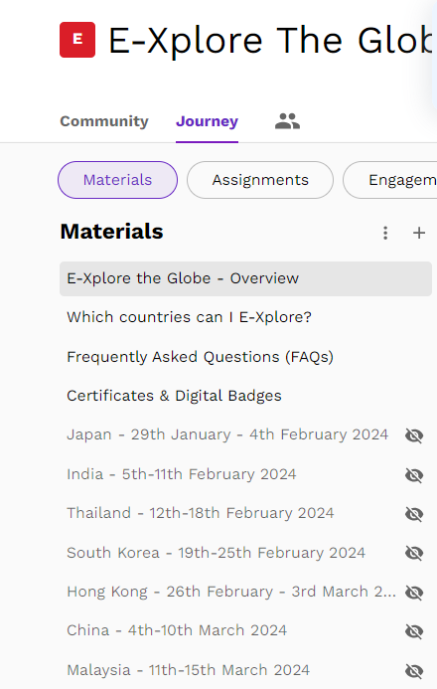
E-Xplore The Globe Aula Page
Welcome to the E-Xplore The Globe Community
The community page will be regularly updated with webinar reminders and upcoming events taking place on the project, you can use this page as a discussion forum or to network.
The journey page is where E-Xplore The Globe begins. This page contains introductory information and the destinations you can currently visit as part of the tour. Click on the individual countries to build your cultural competencies through a range of activities and resources. Please log in regularly to gain access to new events and exciting destinations.
Thank you for joining E-Xplore The Globe. If you have any questions or queries please email: globalexperience@coventry.ac.uk
For regular updates, please follow or like us on Social Media:
Instagram Facebook Twitter LinkedIn

