Slide 1


KA203 - Strategic Partnerships for higher education
Support of the Snoezelen concept
and its integration into university education
2020-1-CZ01-KA203-078267
9/1/2020 – 8/31/2023

Slide 2
Nadpis
kapitoly
Coordinator:
Slezská univerzita v Opavě, the Czech Republic
www.fvp.slu.cz
(Below SU)
Partners:
Akademia Wychowania Fizycznego im. Bronisława Czecha w Krakowie, Poland www.awf.krakow.pl
(Below AWF)
Universidad de Lleida, Spain
www.udl.cat
(Below UdL)

Slide 3
Nadpis
kapitoly
The MAIN GOAL of the project (in the way of Erasmus+)
spread and discuss information about Snoezelen at participated universities
and
prepare a comprehensive instructional methodology and a syllabus of Snoezelen course so that the course is applicable in an international student mobility.

Slide 4
Nadpis
kapitoly
THE ORIGIN OF THE PROJECT AND MY GOALS IN QUESTIONS
Is Snoezelen a method whose philosophies and principles have spread and consolidated to form a kind of dogma that trainers and practitioners do not question and build their work on?
What are the similarities and factors of Snoezelen trainings not only at universities?
What do students think of Snoezelen?
What emerges as a problem in the development of Snoezelen?

Slide 5
Nadpis
kapitoly
Project activity types:
(Obligatory activities of this type of the project – Erasmus+)
INTELLECTUAL OUTPUTS (book, articles, videos, syllabus of the course etc.)
TRANSNATIONAL PROJECT MEETINGS (M1-4)
MULTIPLIER EVENTS (E1-6)
LEARNING, TEACHING AND TRAINING ACTIVITIES (C1-6)

Slide 6

Nadpis
kapitoly
TRANSNATIONAL PROJECT MEETINGS (M1-4)
M1 – October 2020, SU Opava
M2 – October 2021, AWF Krakow
M3 – May 2022, UdL Lleida
M4 – March 2023, SU
REAL MEETINGS
Focused on: organizing, coordinating and an agreement on activities for certain period, making an assignment of project tasks and dates, performances and completing the tasks…etc. ☺

Slide 7
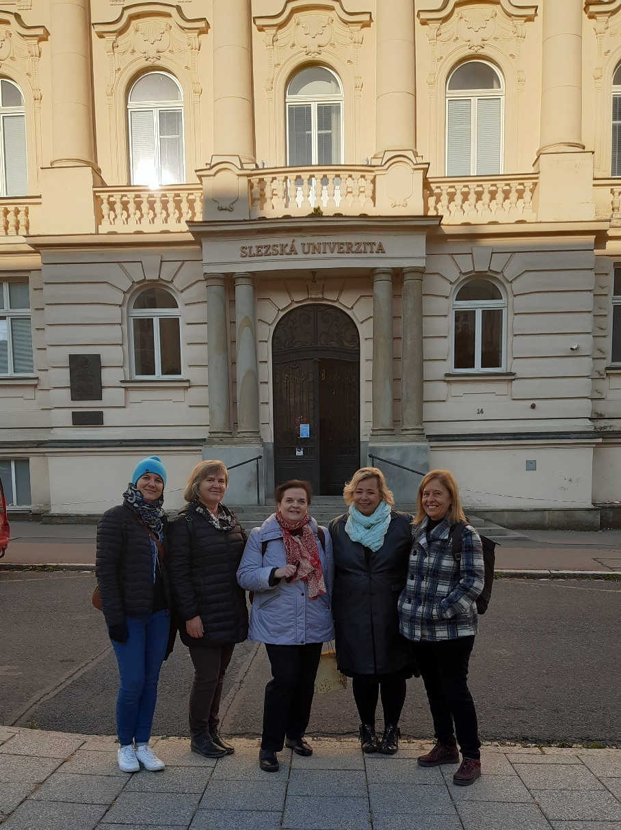
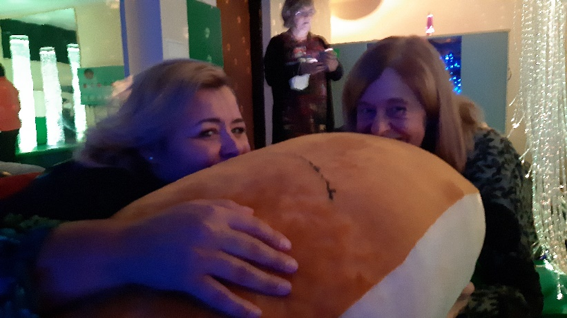
Nadpis
kapitoly

Slide 8
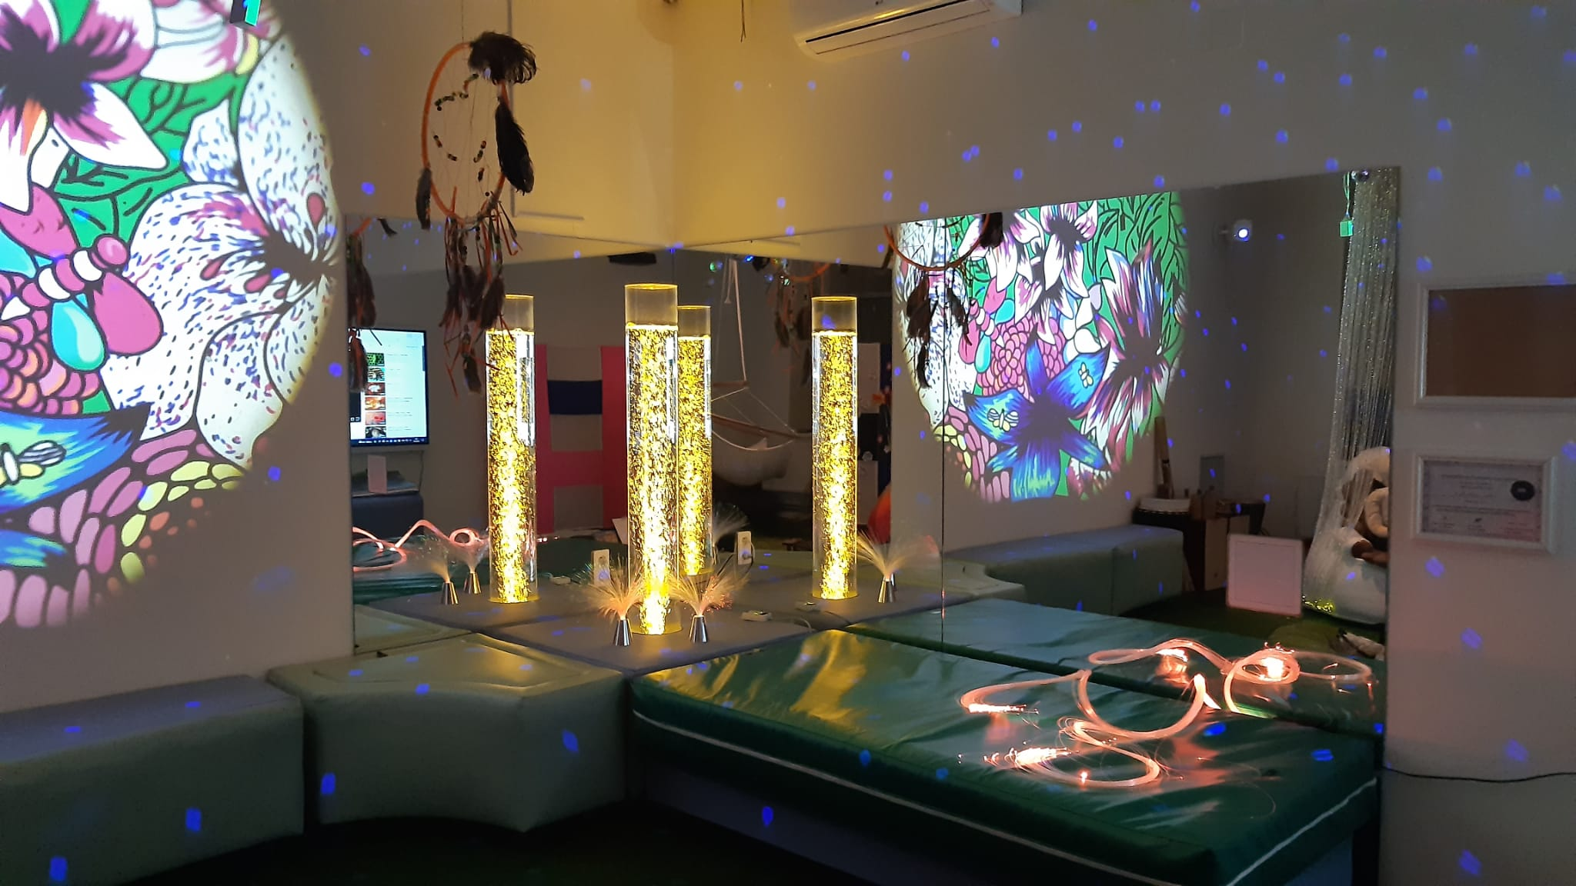
Nadpis
kapitoly

Slide 9
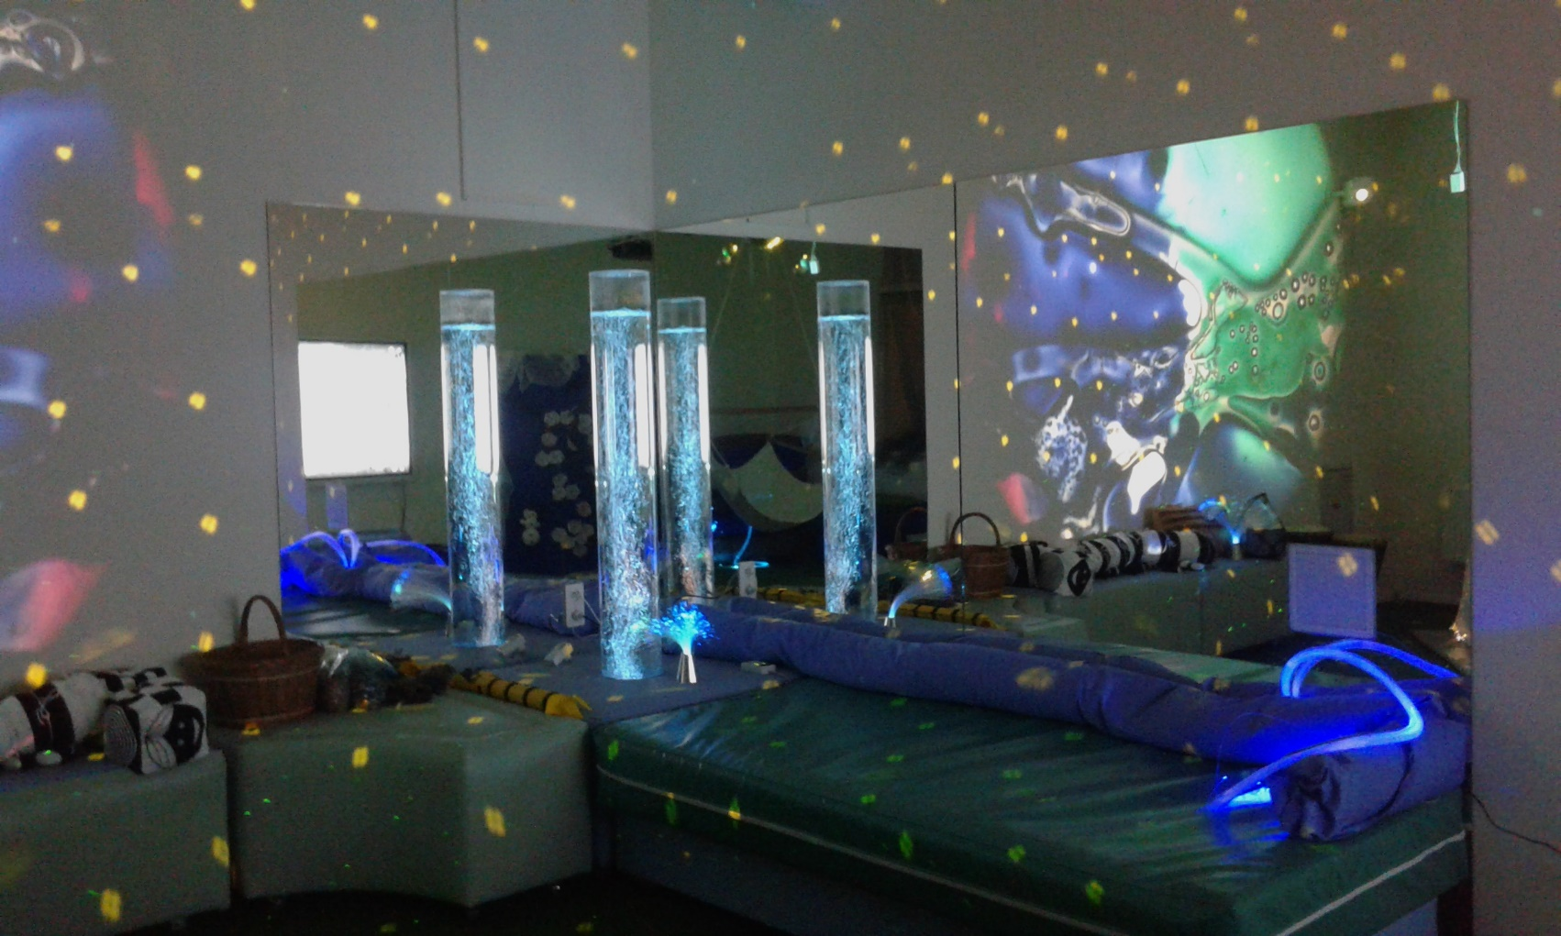
Nadpis
kapitoly

Slide 10
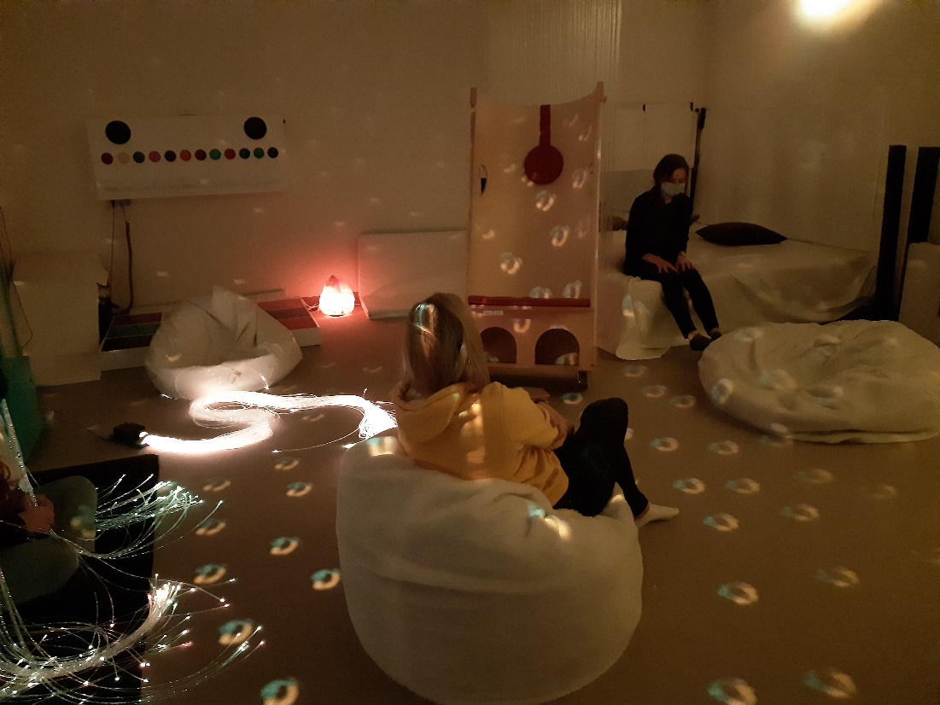
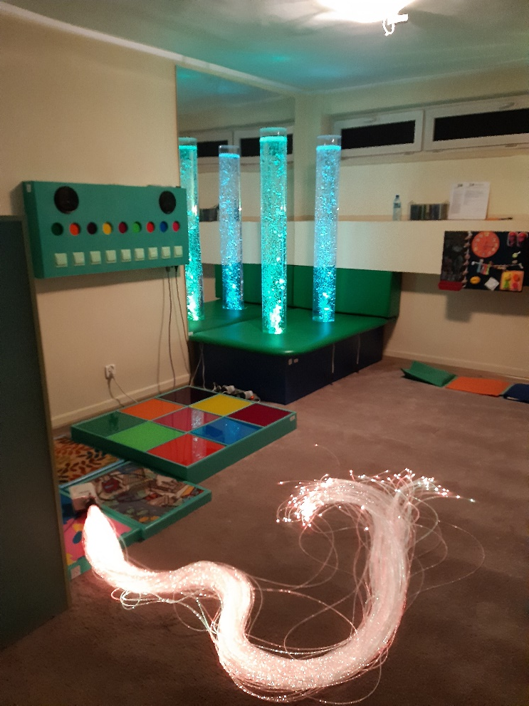
Nadpis
kapitoly

Slide 11
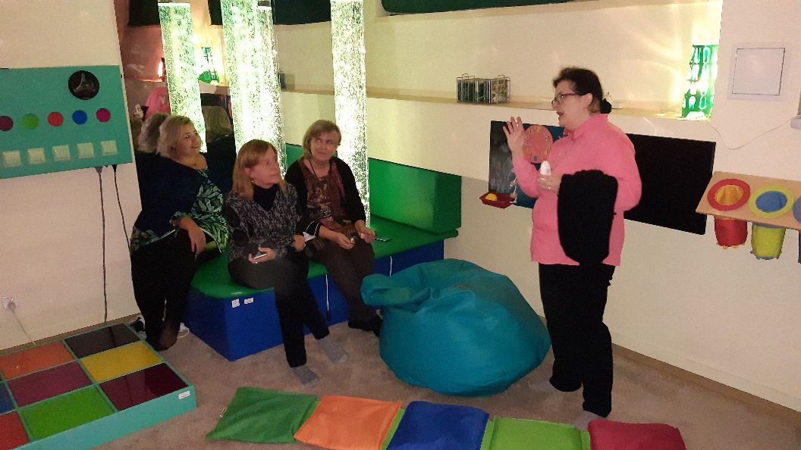
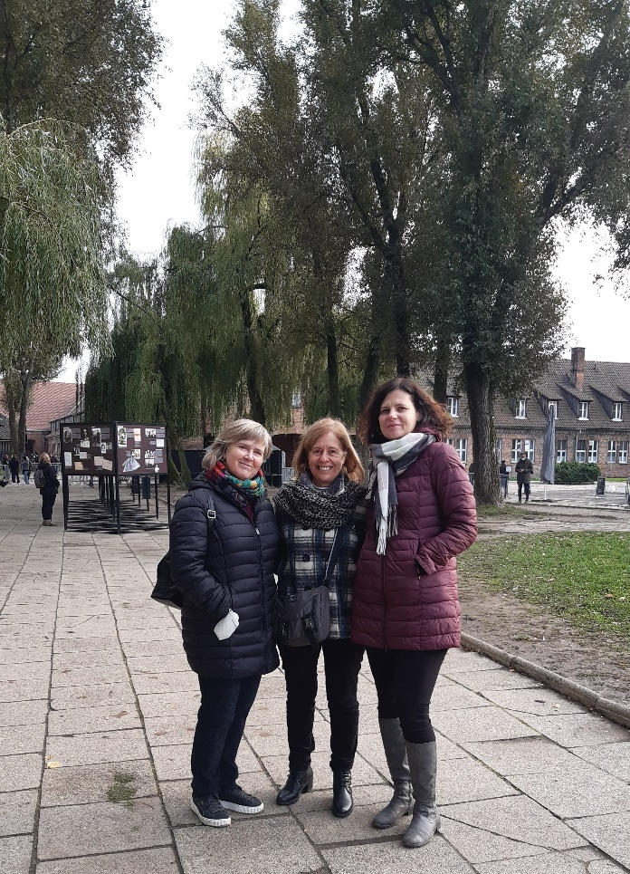
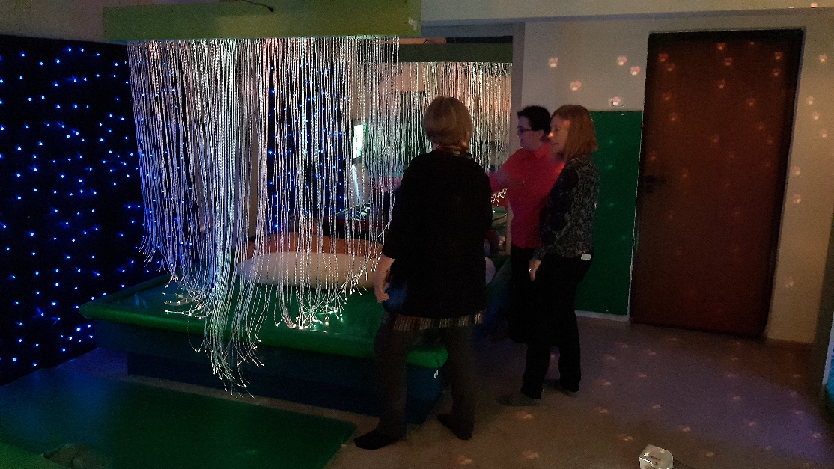
Nadpis
kapitoly

Slide 12

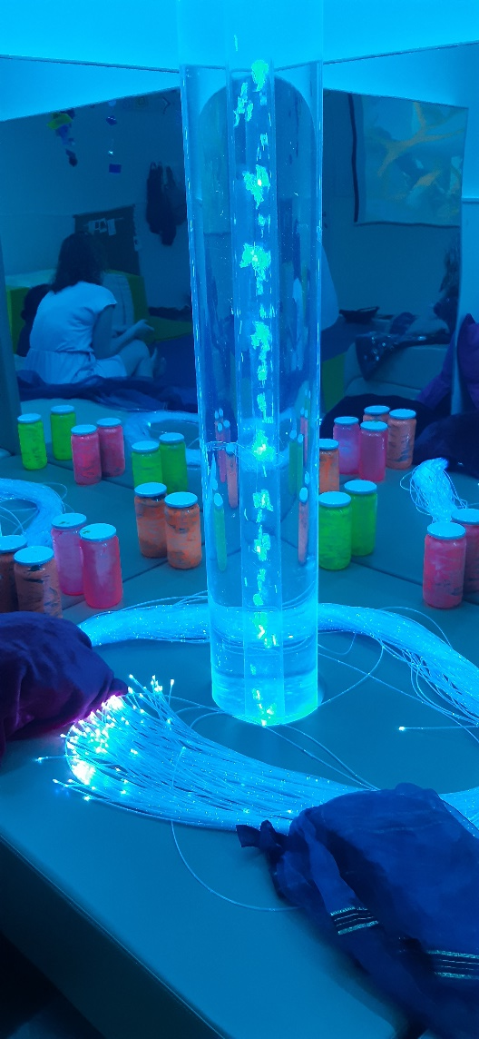
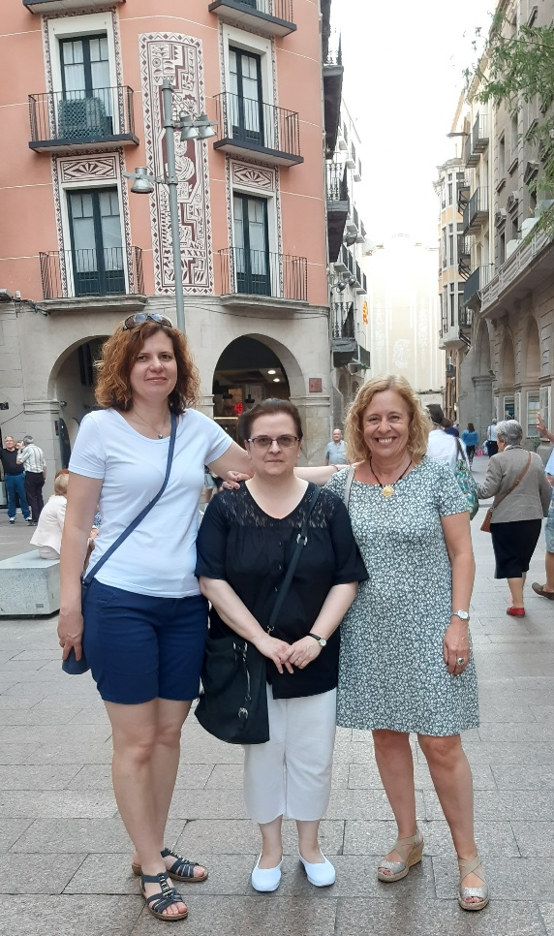
Nadpis
kapitoly

Slide 13
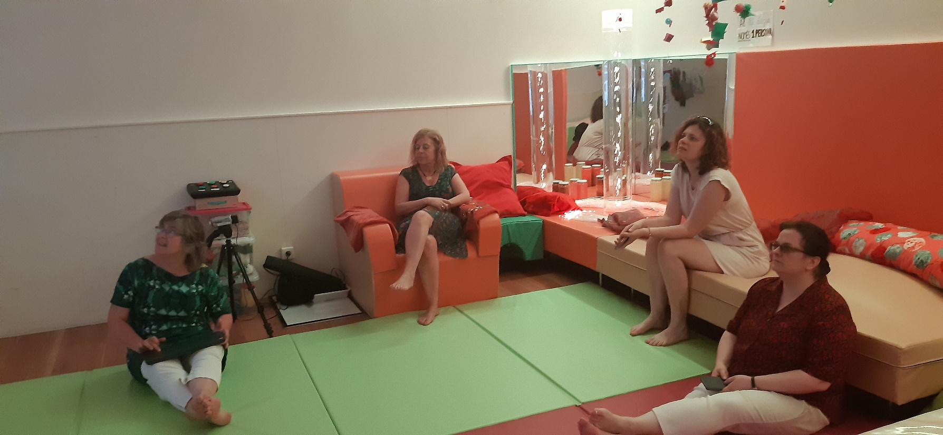
Nadpis
kapitoly

Slide 14
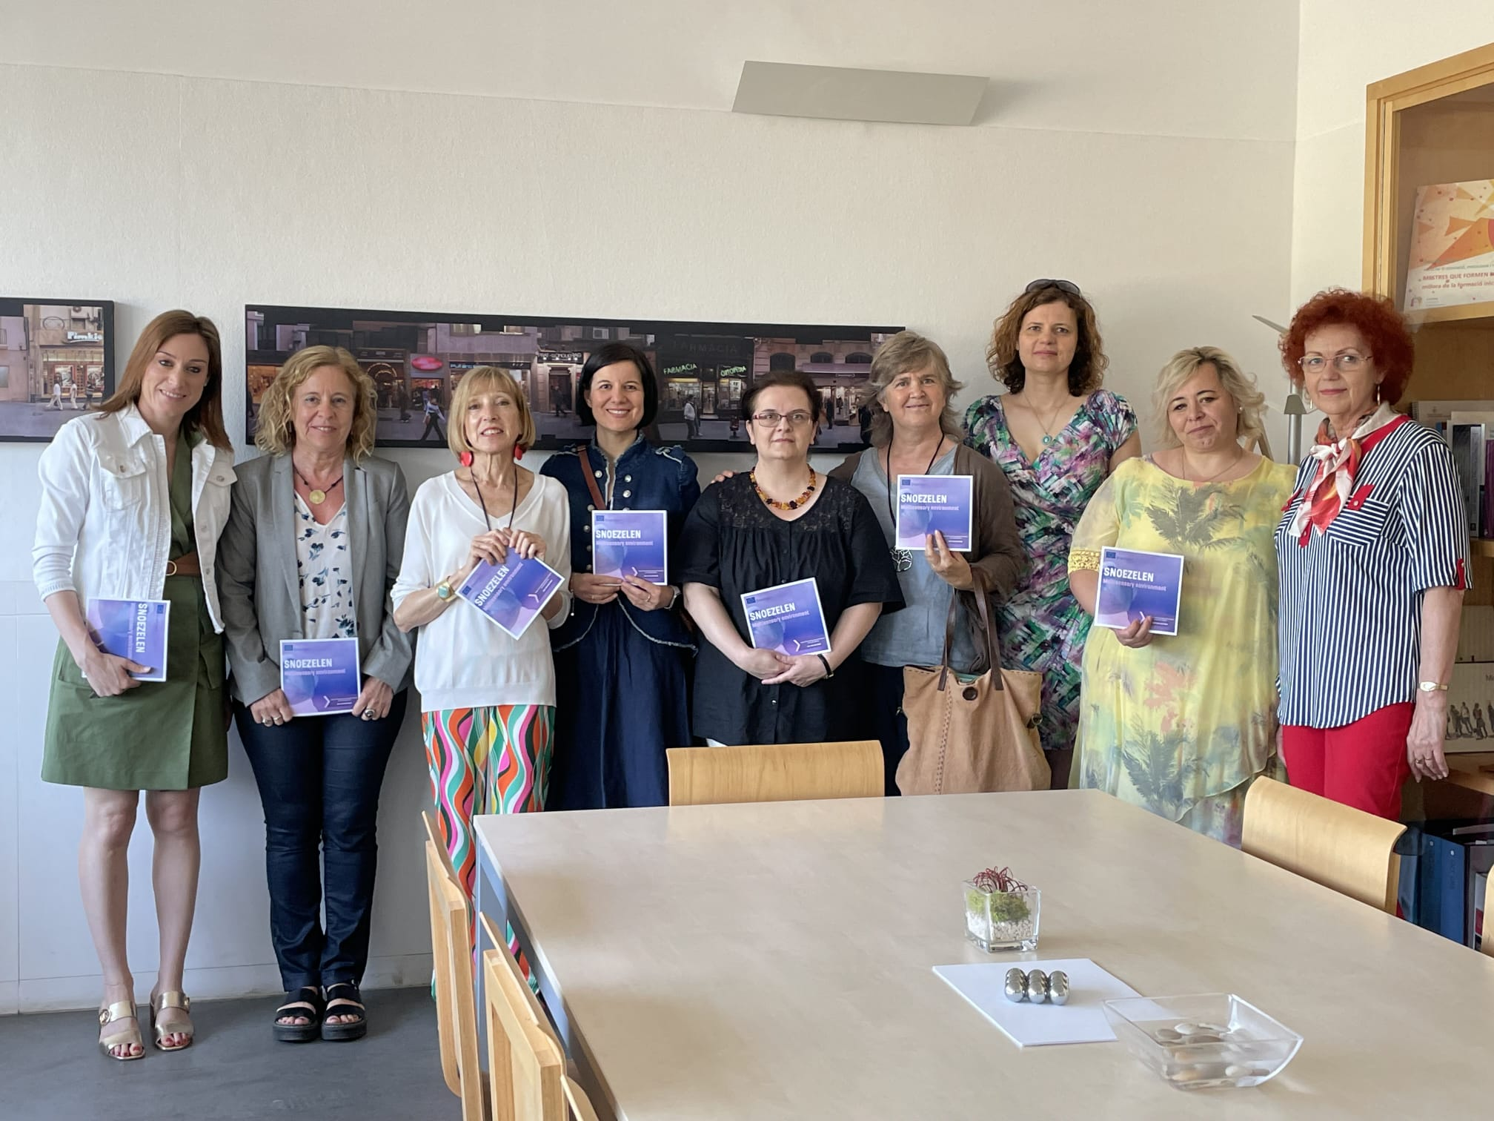
Nadpis
kapitoly

Slide 15

Nadpis
kapitoly
MULTIPLIER EVENTS
E1 – E3 cycle March 2022
E4 – E6 cycle March 2023
Local activities held at each university twice a project duration
Workshops for professionals and those interested in Snoezelen I. & II.

Slide 16
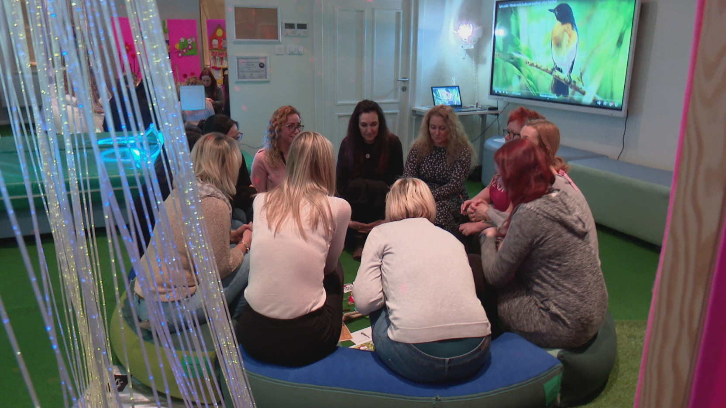
Nadpis
kapitoly

Slide 17
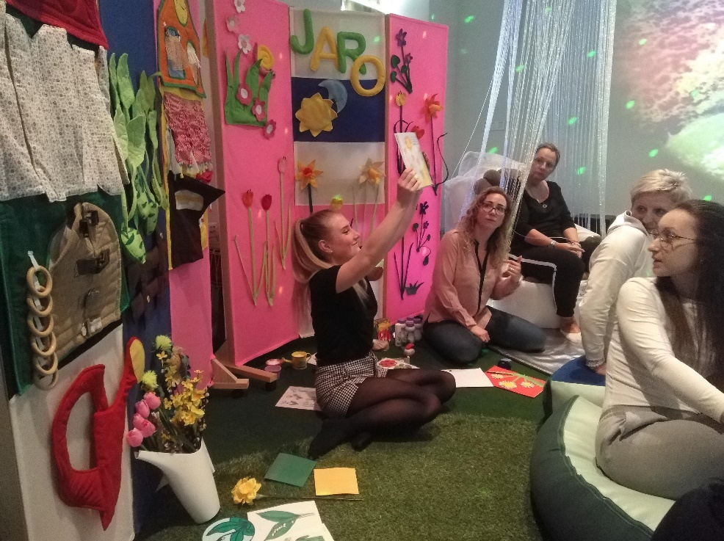
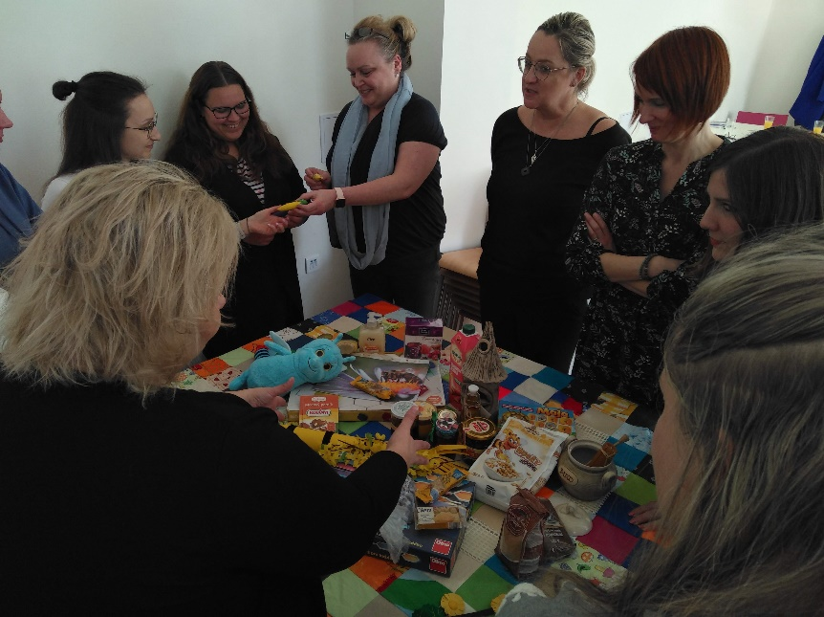
Nadpis
kapitoly

Slide 18
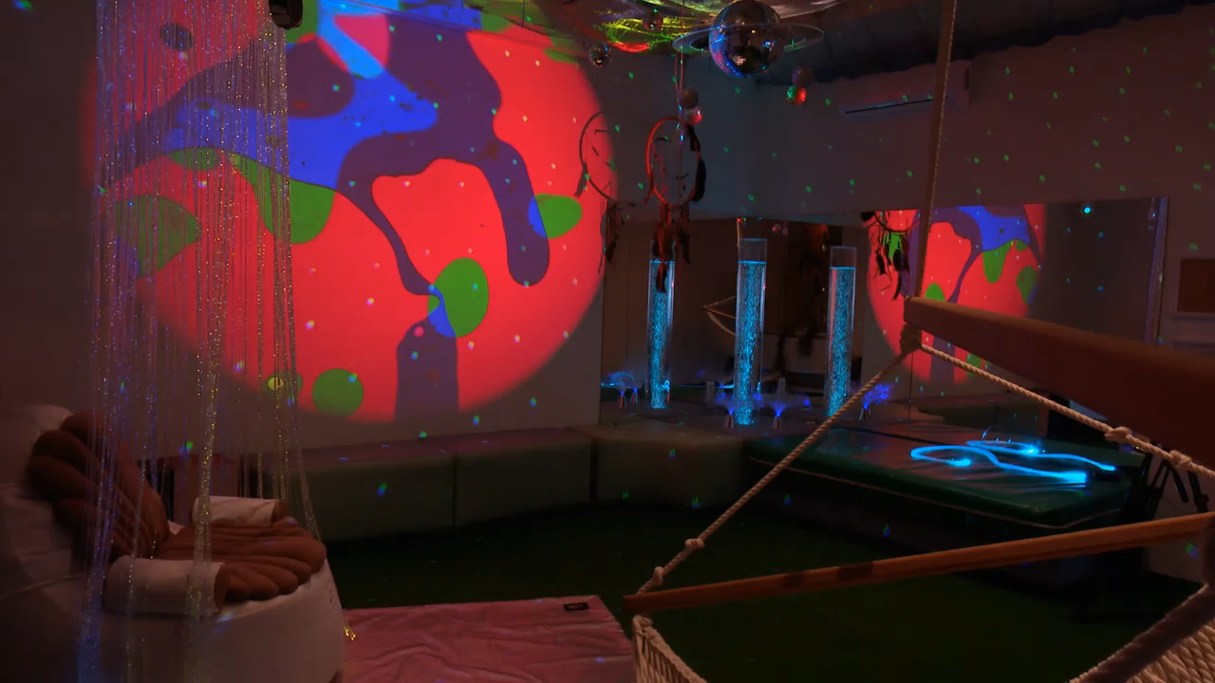
Nadpis
kapitoly

Slide 19

Nadpis
kapitoly
LEARNING, TEACHING AND TRAINING ACTIVITIES (C1-6)
C1 – October 2021, SU (Short-term joint staff training events, 3days )
Special educational context of Snoezelen
C2 – May 2022, UdL (Short-term joint staff training events, 3days)
Psychological and pedagogical contexts of Snoezelen
C3+C4 – October 2022, SU (ISNA – MSE Courses, 5 days)
C5+6 – May 2023, AWF (Courses in Therapies, 5 days)

Slide 20
Nadpis
kapitoly
Let´s get back to my questions at the beginning!
FOUNDED ANSWERS:
The answers are based on discussions, interviews, observations that take place within the project and other activities.
The students' answers were obtained through a questionnaire survey conducted at all three universities participating in the project and statistically evaluated.

Slide 21
Nadpis
kapitoly
Is Snoezelen a method whose philosophies and principles have spread and consolidated to form a kind of dogma that trainers and practitioners do not question and build their work on?
Yes. Snoezelen has clearly stated principles that keep theoretical work within certain limits.
Everyone who trains within Snoezelen adheres to these principles, which also form the skeleton of the work that new practitioners can rely on.

Slide 22
Nadpis
kapitoly
What are the similarities and factors of Snoezelen trainings not only at universities?
The participants of the courses MORE and MORE expect to get methodical examples like a cookbook that they can open and work exactly according to the recipe.
We lack any innovative strategy in the organisation and sequencing of Snoezelen courses.
But, people are still very excited about Snoezelen and demand for ANY courses is still very high.

Slide 23
Nadpis
kapitoly
What do students think of Snoezelen?
These are results of our research: We asked, among others:
What is the most important function of the Snoezelen – MSE?
What is the strongest point of the Snoezelen – MSE?
1. A majority of respondents considered relaxation to be the most important function of the Snoezelen – MSE;
Relaxation was followed by Activation and Stimulation; Support of Communication and Development of Social Skills; Personality Development and Education.
2. As the strongest point of the Snoezelen – MSE was mostly chosen the Possibility of a Personal approach,
Than also Flexibility of the method, and the Possibility of Using Various Methods and Techniques.

Slide 24
Nadpis
kapitoly
All groups of students think that a therapist should work in Snoezelen rooms more often than pedagogues. Why?
This view is based on the fact that most respondents will work as a therapist rather than an educator in their professional future (occupational therapy students, psychology students, special educators and pedagogues).
However, the answer to this hypothesis is also influenced by the nature of the activities in Snoezelen, which are more related to therapies and psychotherapies than to the support of education and cognitive development of clients.
This fact also applies to the existence of Snoezelen rooms, which are more often found in social services and 24 hours services than in schools.

Slide 25
Nadpis
kapitoly
What emerges as a problem in the development of Snoezelen?
Voices of trainers and practitioners:
„ …the necessity of doing serious research in Snoezelen practice, with various groups of patients/clients“
„We need research projects and publications to make this method at least a little evidence-based…“
„…the education of Snoezelen is not only in the hands of ISNA-MSE but also in cooperative universities and colleges…“
„…lets combine these two efforts more often practitioners and scientists“
„…lets continue in development as other therapies – as f.e. musictherapy…Otherwise Snoezelen will not be treated seriously…“
„…Today we cannot rely on intuition anymore… This time is over…“

Slide 26
Nadpis
kapitoly
What emerges as a problem in the development of Snoezelen?
Voices of trainers and practitioners:
„…All parts of the Snoezelen intervention need to be strengthened…and EDUCATED in COURSES“
„…the preparation for effective work in Snoezelen, which is related to the diagnostic profile of the client… „…we must start to apply the correct diagnostic procedures like the Sensory Profile…“
„…the content and preparation of specific activities, which are based mainly on the competencies of professionals practicing Snoezelen“
„…the evaluation of the whole process, which is responsible for the sequence of further steps and the plan of beneficial activities that we will further implement.“

Slide 27
Nadpis
kapitoly
Let´s share our ideas about Snoezelen!
Ideas are the beginning points of all fortunes.
Napoleon Hill
If I have a thousand ideas and only one turns out to be good, I am satisfied.
Alfred Bernhard Nobel

Slide 28
Nadpis
kapitoly
Thank you for your time!
☺

Slide 29
Nadpis
kapitoly
Kateřina Janků
katerina.janku@fvp.slu.cz
+420 724 395 307

