Slide 1


Slide 2
About the University
Silesian University in Opava was founded in 1991.
Faculty of Philosophy and Science in Opava
Faculty of Public Policies in Opava
Mathematical Institute in Opava
Institute of Physics in Opava
School of Business Administration in Karviná
Notes:
csvukrs

Slide 3
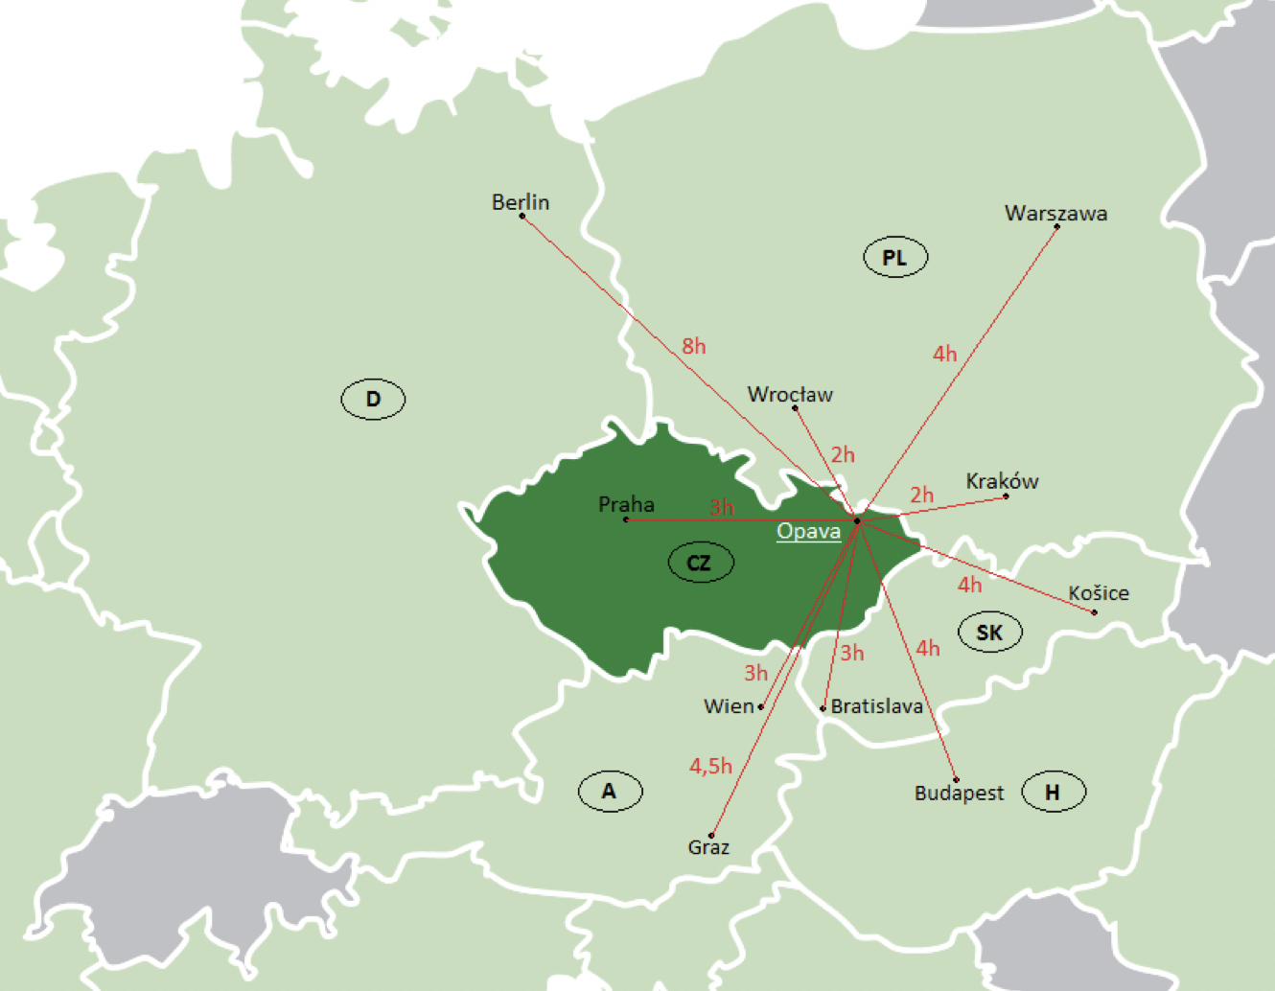
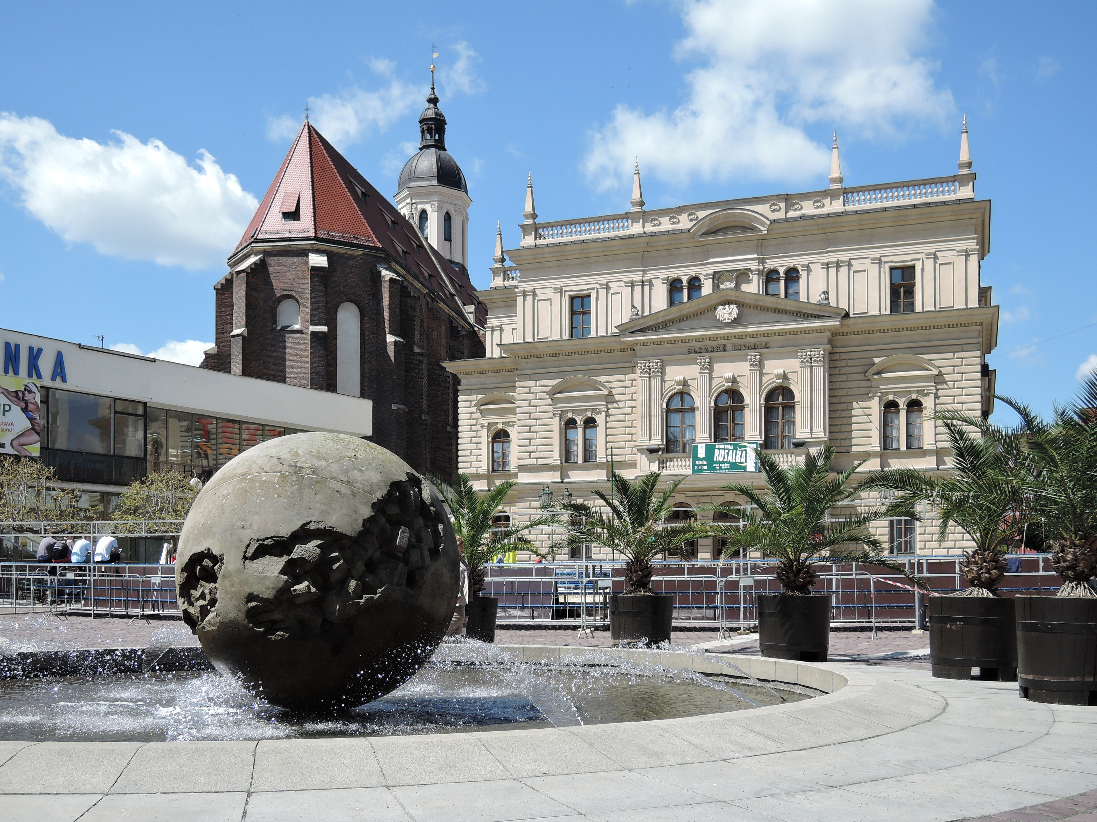
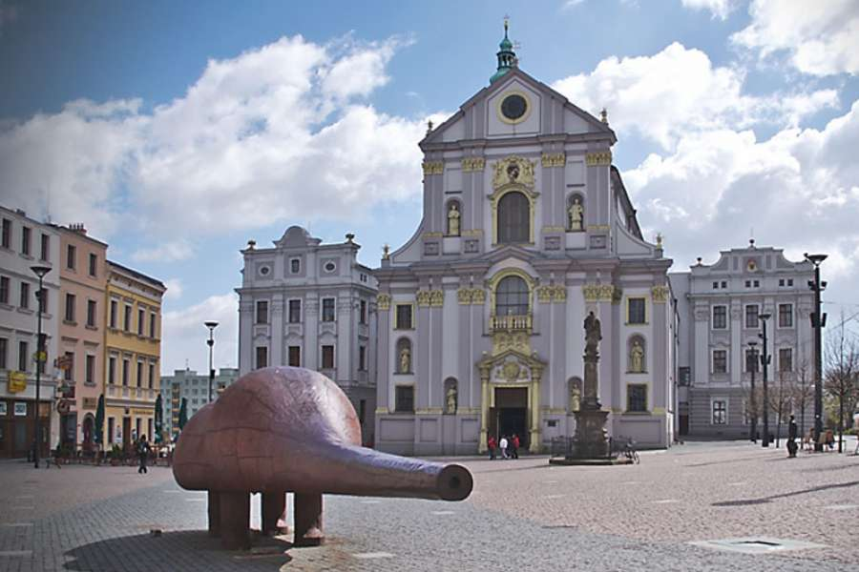
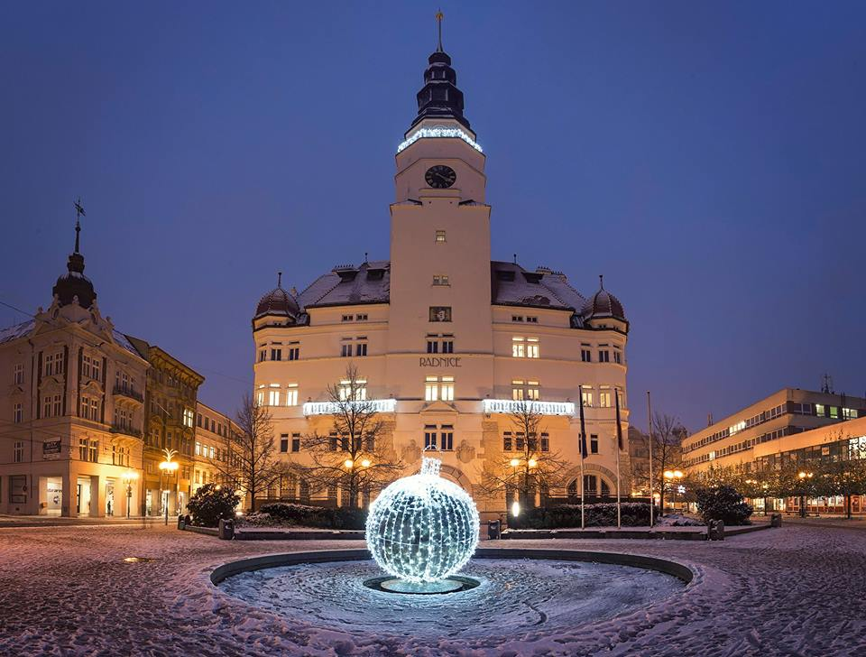
About Opava
Area: 90,61 km²
Population: 56 834

Slide 4
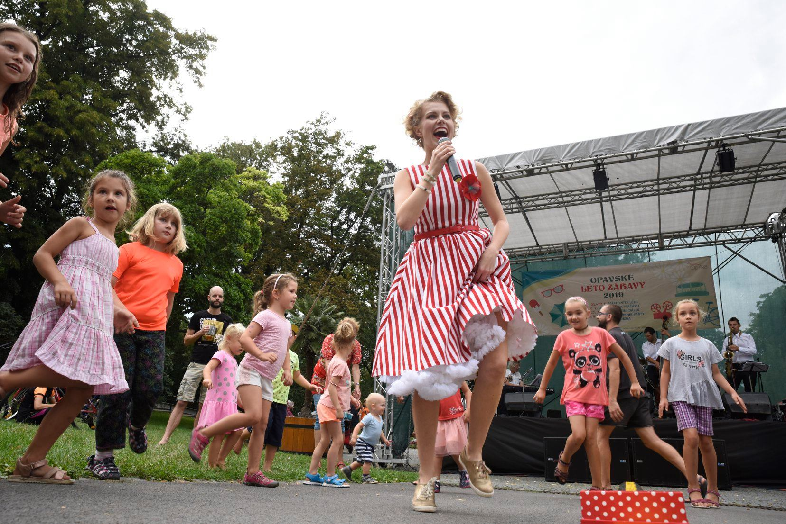

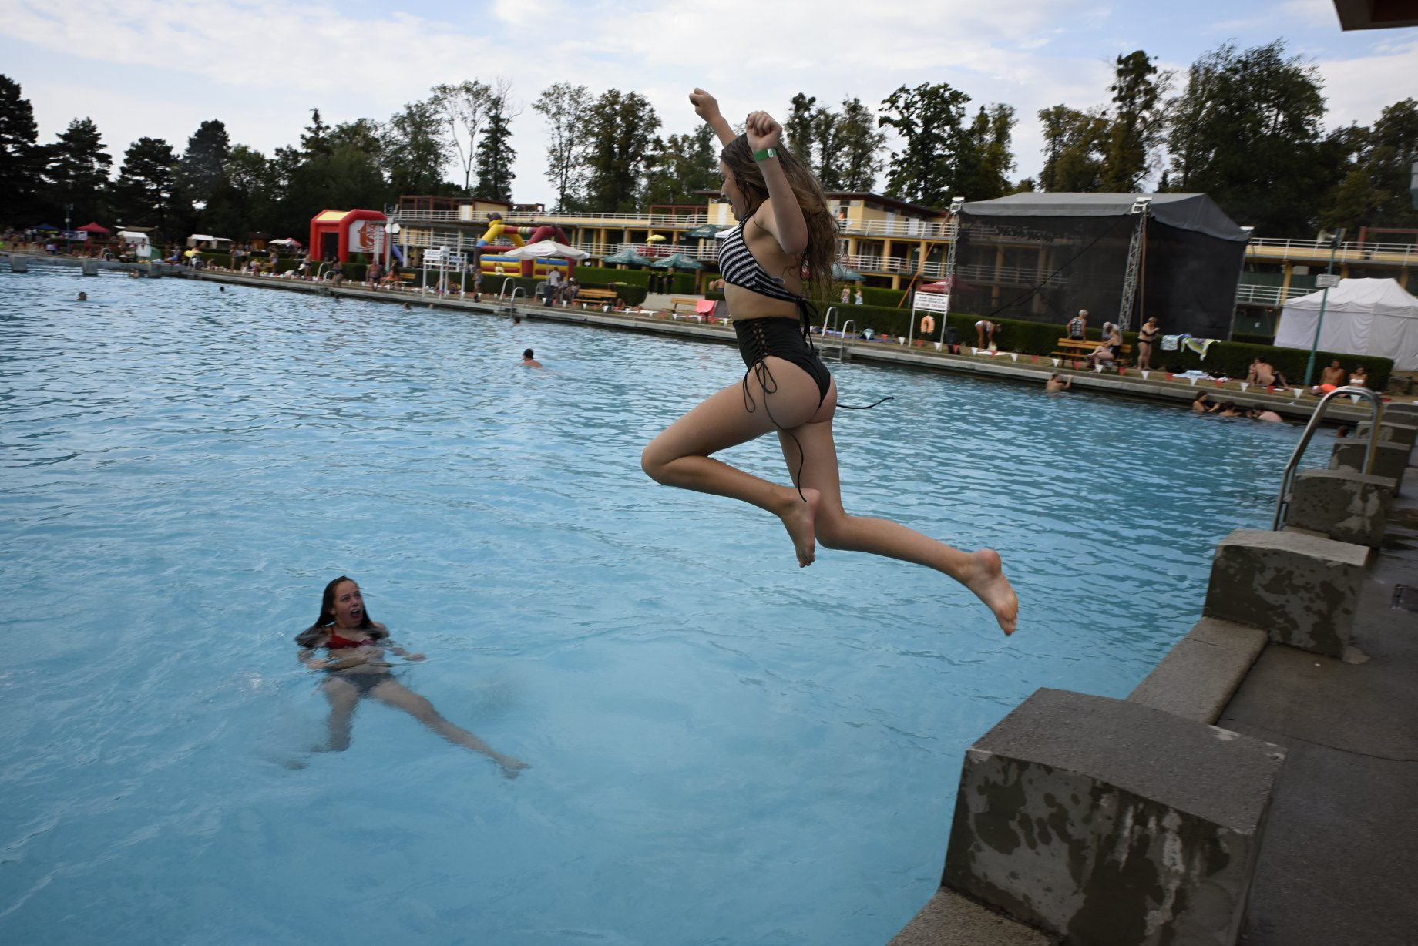
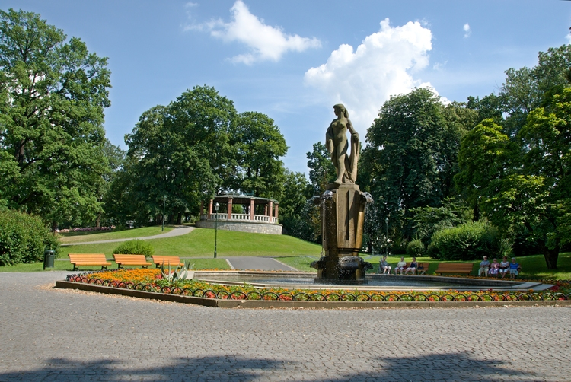
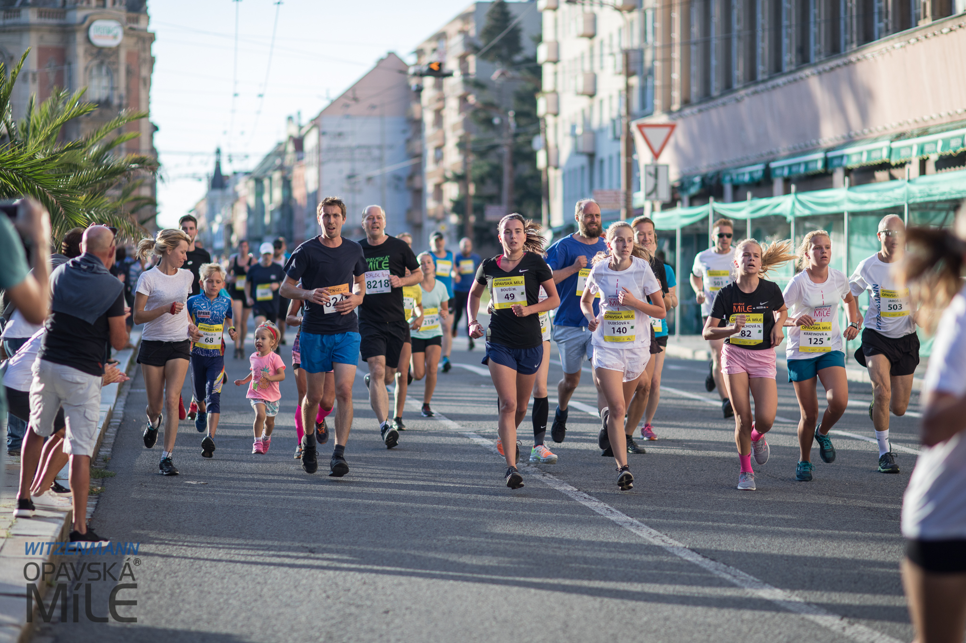
Culture life, free time and sport activities
Festivals
Events
Exhibitions
Theatre
Museum
Parks
Sport
Pubs & Restaurants

Slide 5
Faculty of Public Policies in Opava
The Faculty of Public Policies was established in 2008.
Vocational degree programmes with high share of practical education
Study in modern specialized classrooms
Varied offers of international internships and certified courses
Extensive cooperation with foreign partners
Involvement in research

Slide 6


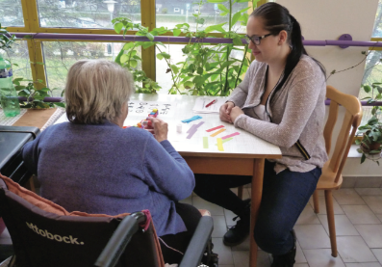

Degree Programmes and Institutes
Graduates find wide application in a number of practical study programmes!
Paramedical programmes
- General Nurse
- Dental hygiene
- Pediatric Nursing
- Midwifery
Psychologically Oriented Programmes
- Special Education
- Social Pathology and Prevention
- Educational Care for the Elderly
Programmes in Public Administration
- Public Administration and Social Policy

Slide 7
Partner Universities - Erasmus+ and CEEPUS
Within the Erasmus + framework, we cooperate with Slovakia, Hungary, Slovenia, Italy, Poland, Germany, Spain, Portugal, Croatia, Latvia, Turkey and Bulgaria
Within the CEEPUS framework, we cooperate with the Czech Republic, Slovakia, Poland, Hungary, Slovenia, Bulgaria, Northern Macedonia, Montenegro, Romania and Austria

Slide 8
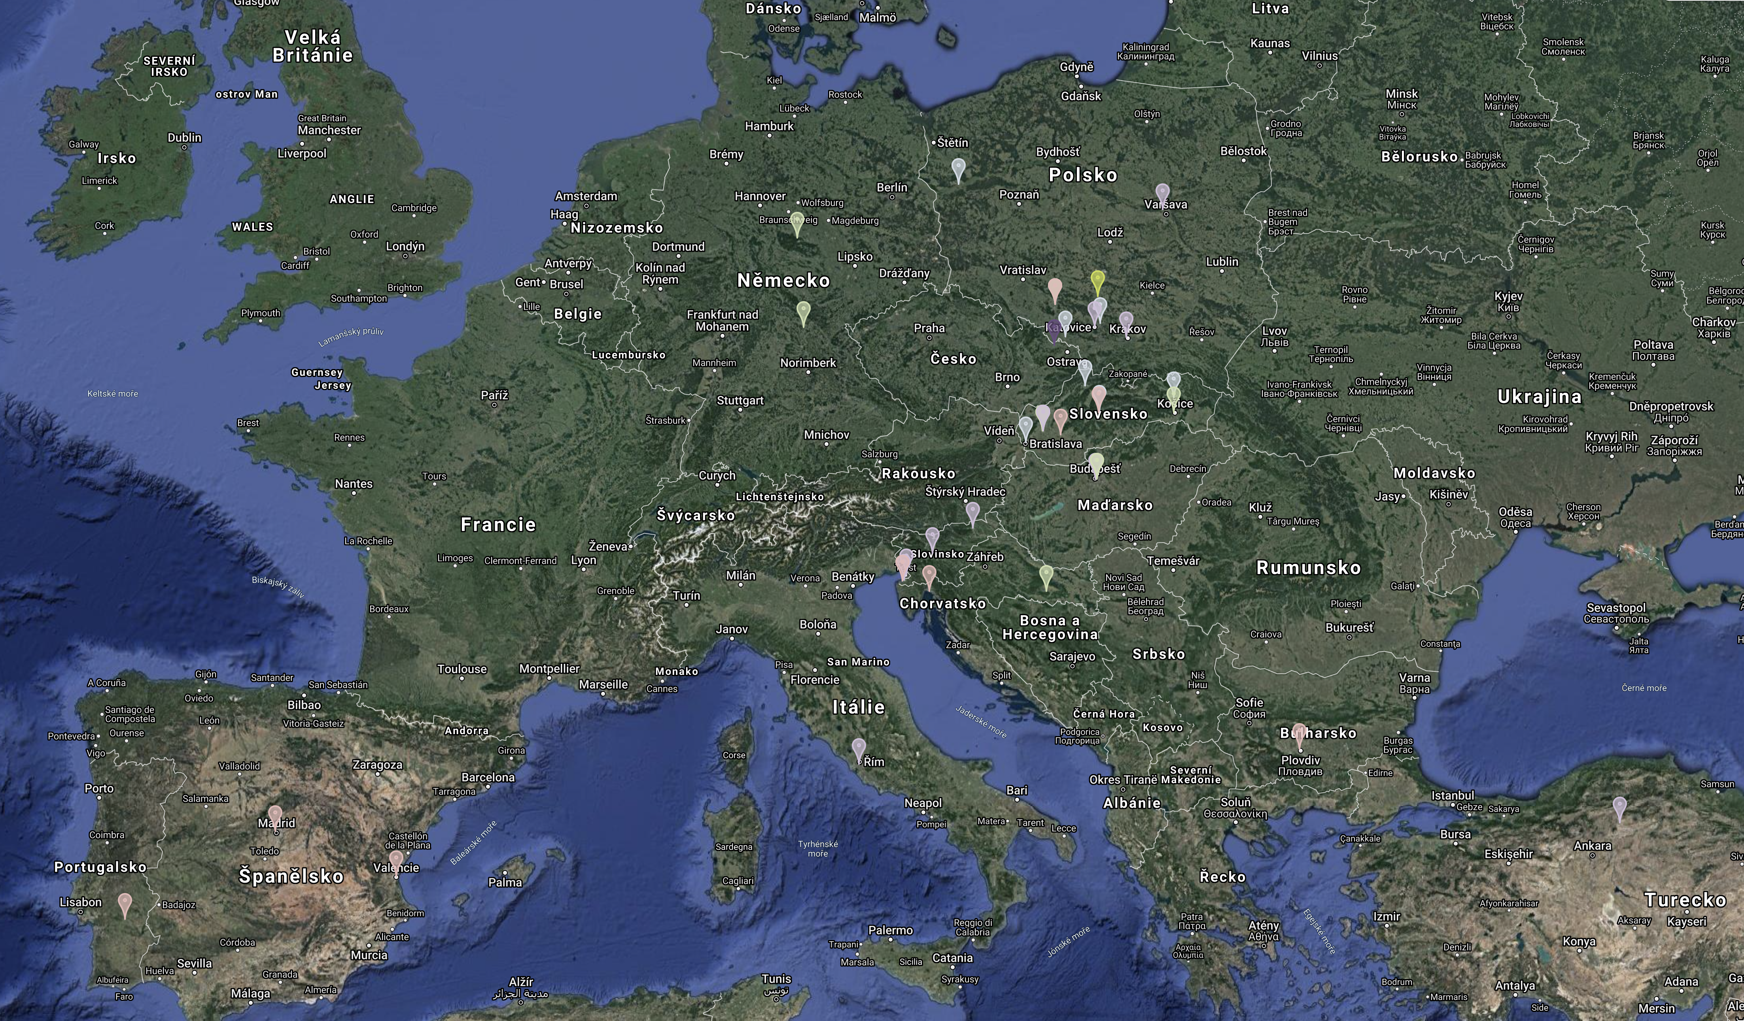
Map of Erasmus+

Slide 9




Scientific Journals
Central European Papers (C.E.P.)
Social Pathology and Prevention (S.P.P.)
Nursing Perspectives
Public Administration and Social Policy

Slide 10

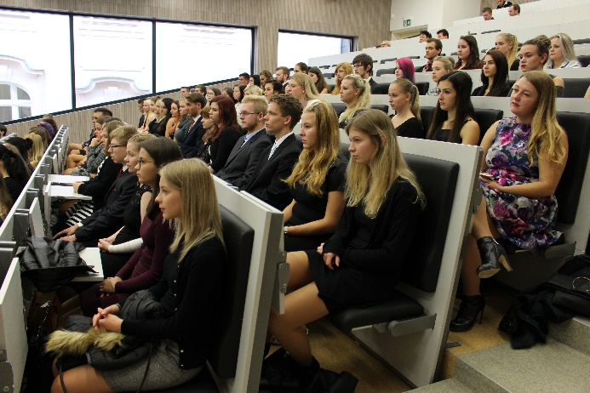
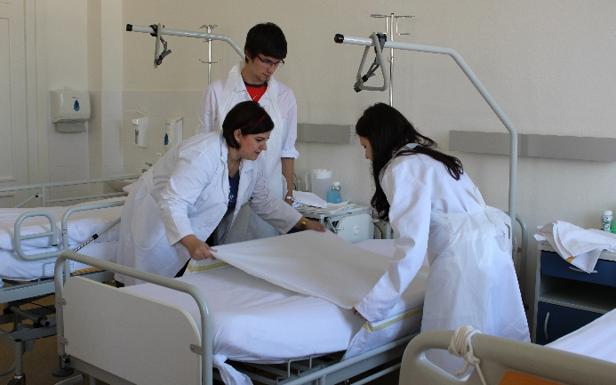
Modern faculty

Slide 11
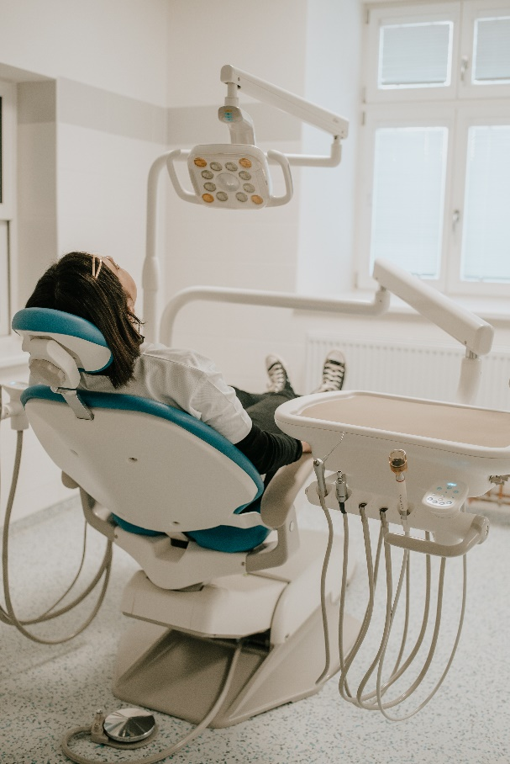
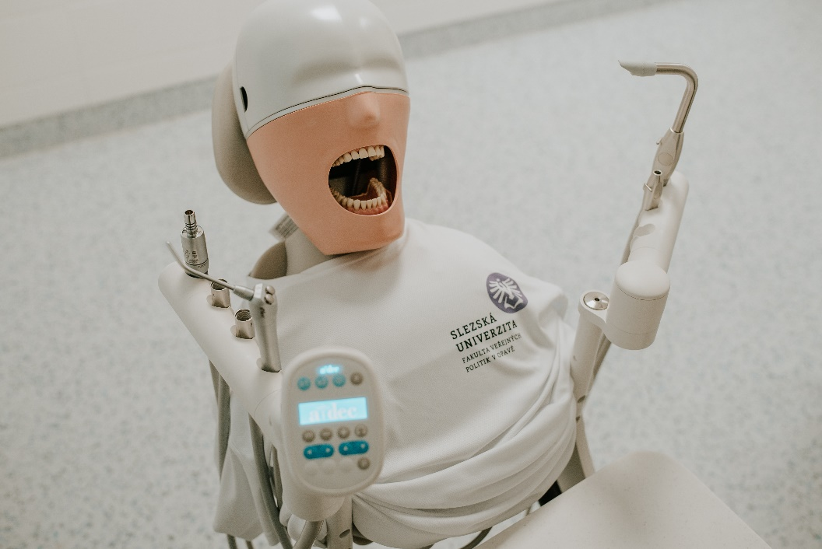
Specialized classrooms - Dental hygiene

Slide 12
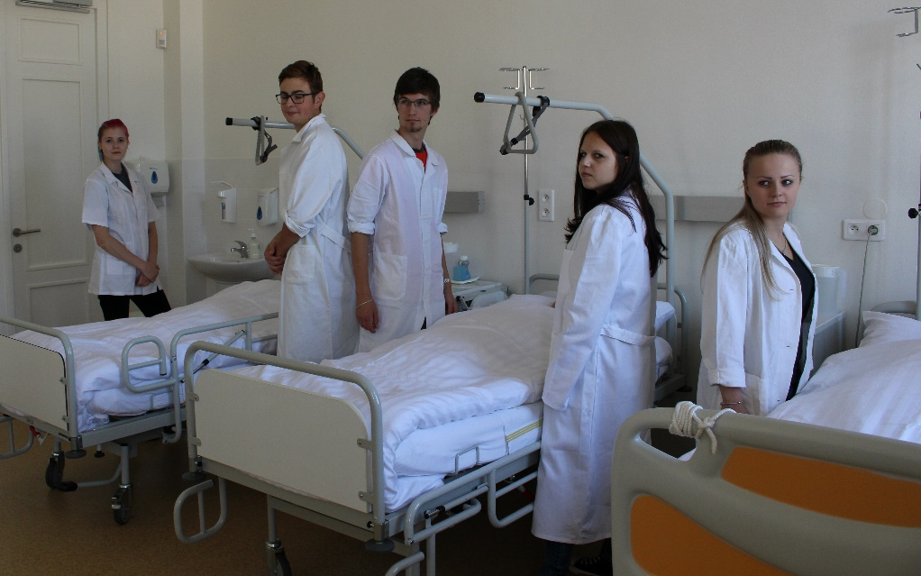
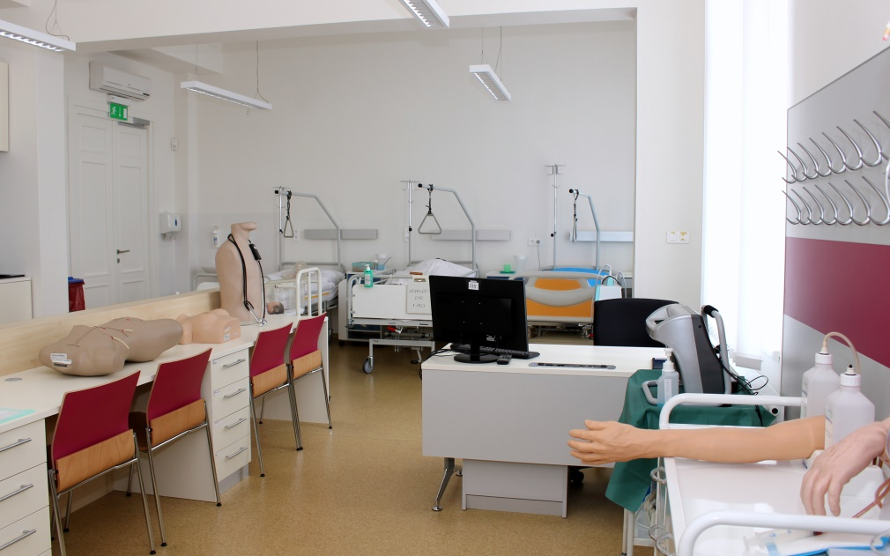
Specialized classrooms - General Nurse

Slide 13
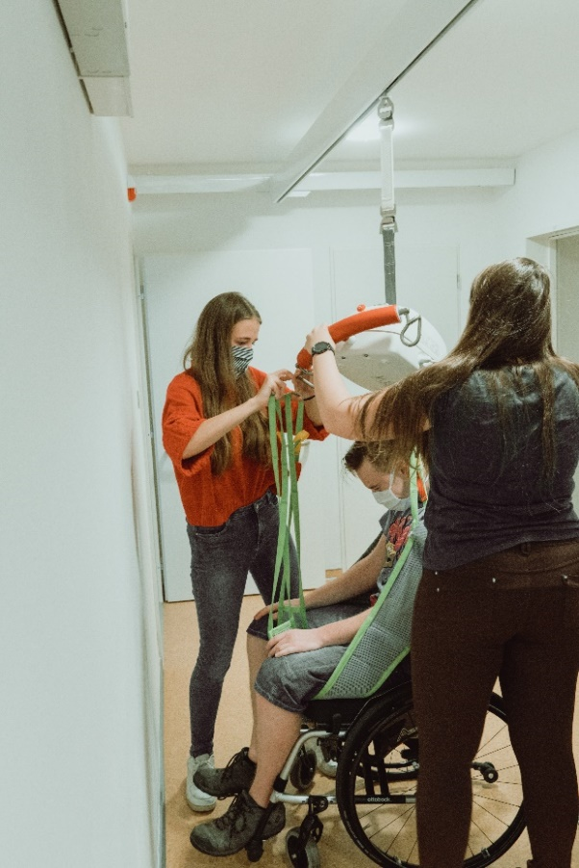
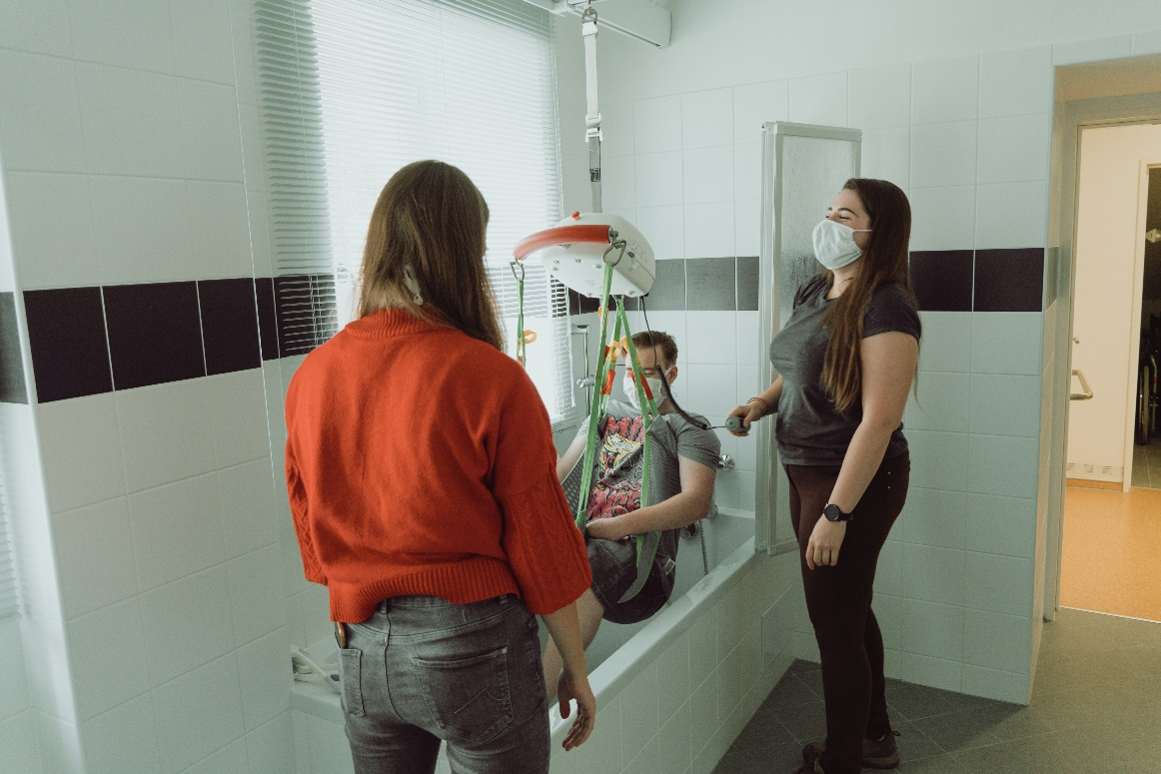
Specialized classrooms - Educational apartment

Slide 14
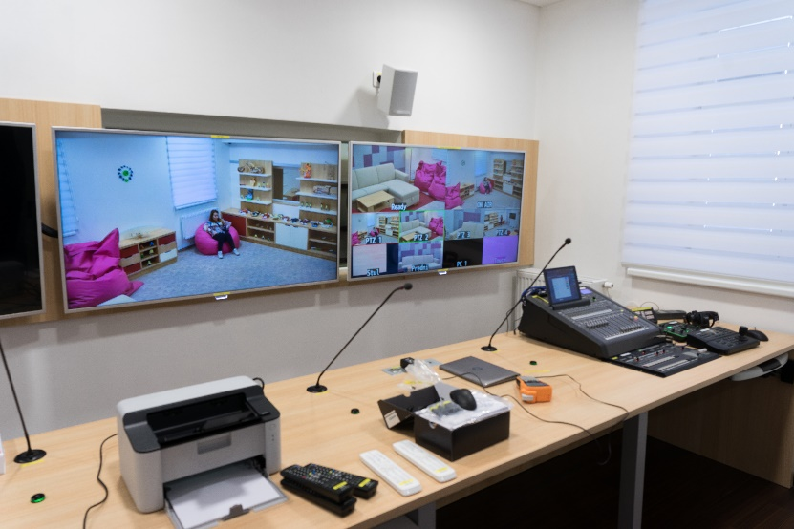
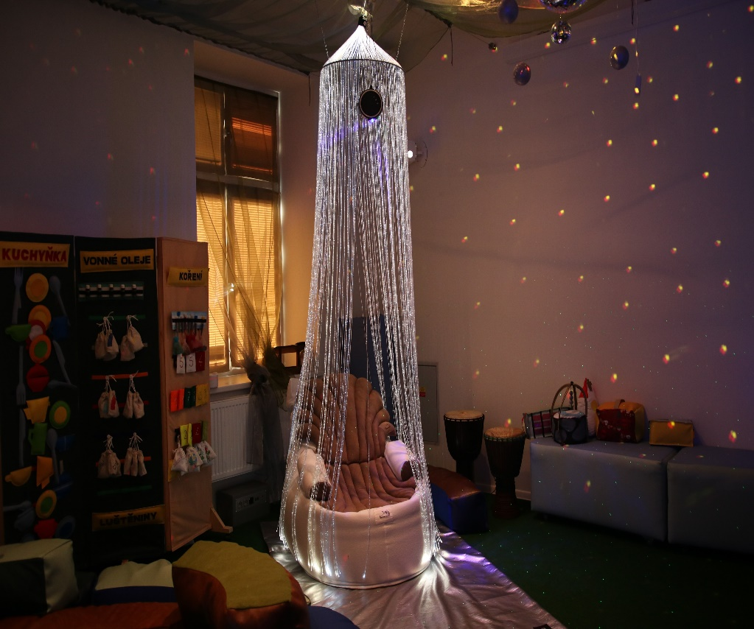
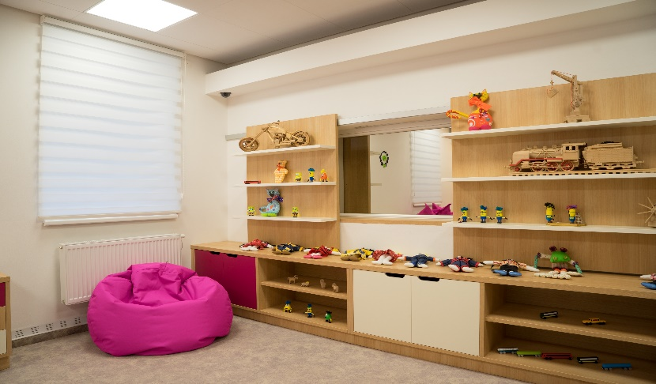
Specialized classrooms - Interviewing room and Snoezelen

Slide 15
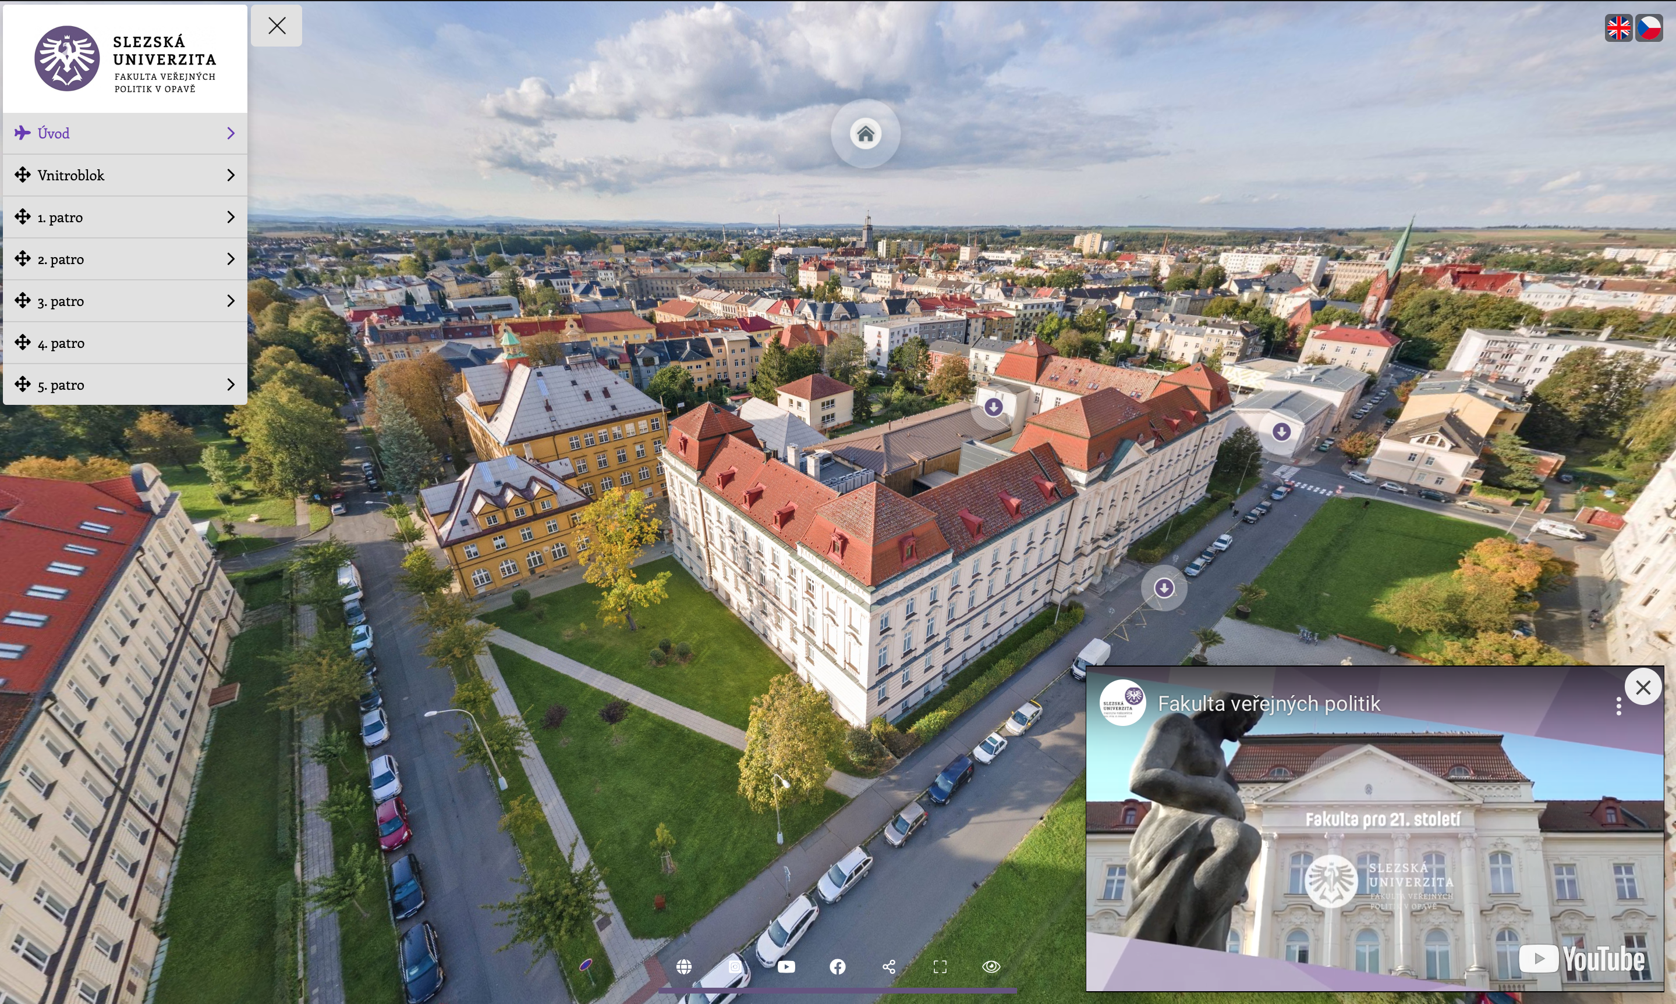
Virtual Tour of the Faculty
Welcome: https://1url.cz/LzAbR

Slide 16



Where to find us?
Faculty website: https://www.slu.cz/fvp/cz/
@slu.fvp
@fakultaverejnychpolitik
Fakulta veřejných politik v Opavě

Slide 17
Thank you for your attention!
(Presenter’s Contact Info)
Name and surname
E-mail / Phone

